Slide 1

PYTHON CSE 10 B GROUP 7

Slide 2
ATM GUI SYSTEM
PRESENTED BY : GROUP 7

Slide 3

NAMES UID
AKASH 20BCS7377
AYUSH KUMAR RAI 20BCS7391
MOHIT SHARMA 20BCS7350
MAYANK PRAKASH 20BCS7367
OM ANIL GONADE 20BCS5975
SOHAM KR MODI 20BCS7352
SAKSHAM VATS 20BCS7370

Slide 4
PURPOSE
The main purpose of this program is to develop better understanding of ATM machine for beginners.
The project explains proper functioning of ATM to the user.
This program promotes safe electronic banking.

Slide 5
FEATURES OF ATM GUI SYSTEM
Faster Cash withdrawal
Transfer money from one account to another
Instant balance enquiry
Change pin
Debt paying
Provide Graphic interface to user.

Slide 6
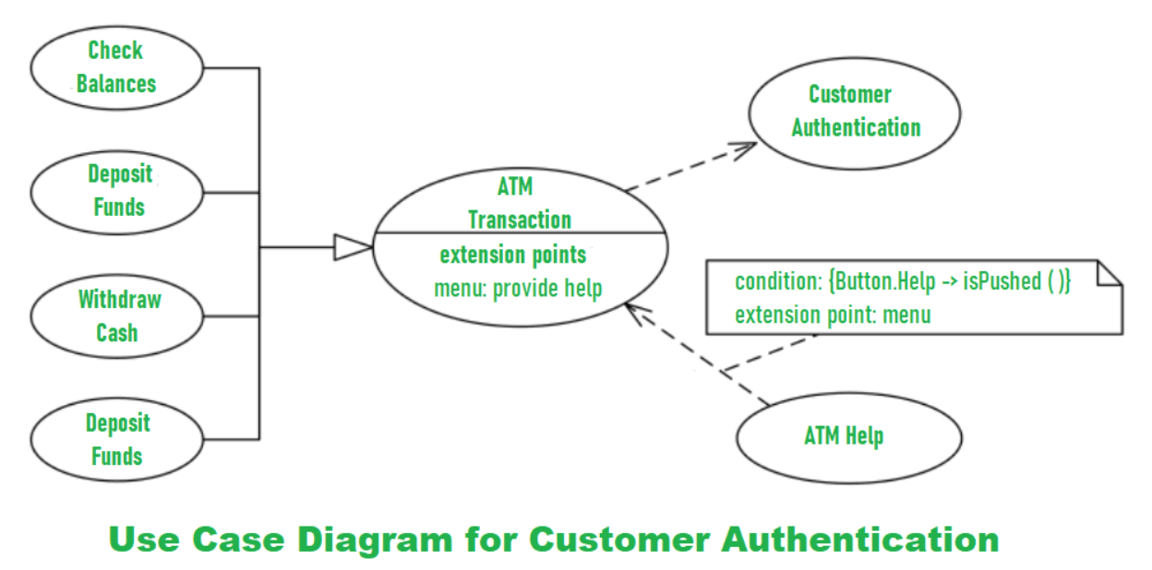
ARCHITECTURE OF ATM SYSTEM

Slide 7
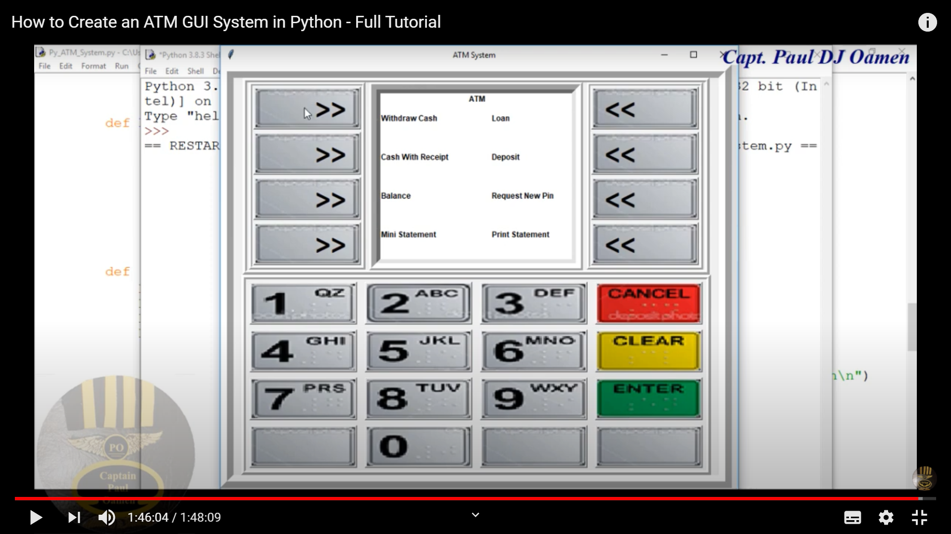
SOFT COPY
Expected output

Slide 8
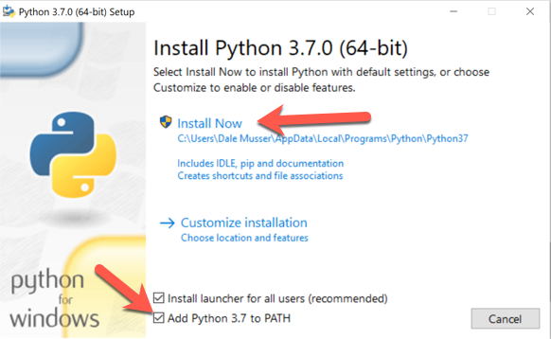
SOFTWARE USED
PYTHON 3.7.0

Slide 9
USES OF PROGRAM
The application allows customer to collect cash and transact money .
It allows authorized user to access the system by entering his/her ATM card.
This application allow to change pin and inquiry account balance of customer.

Slide 10
How is it implemented ?
Import tkinter to add graphic interface.
Import library functions.
Includes designing of the class and its method.
Insert buttons images for graphic user interface.
By using functions we write main program which runs ATM system.
We will add ATM features such as Withdrawal , Cash deposit system, Check balance etc. through coding.
Make database to store information of users which will be used in our ATM.

Slide 11
RESPONSIBILITIES OF GROUP MEMBERS
DATABASE by Mohit
Withdrawal program by Mayank
Authentication by Ayush
GUI by Akash
Cash deposit program by OM
Balance inquiry by Saksham
Debugging by Soham

Slide 12
Conclusion
The project “ATM GUI SYSTEM” will be developed as the best flexible and efficient project within available resources and time.
In future we are planning to add new feature like Fingerprint reader and Face Recognition system for authentication of user security purpose.
Care will be taken at each step to make it more user friendly so that user can add new features wherever necessary while using automated system. It may be enhanced according to the requirement of user .

Slide 13
